Slide 1

Team 3 - Proposal
20102128 Yu Jeong Hwang
22170111 Halim Youssef
18102089 Jeong Woog Lee

Slide 2
TABLE OF CONTENTS
01
02
03
04
Problem Definition
Data Source
Purpose of the Analysis
Project Plan

Slide 3

01
Problem Definition

Slide 4
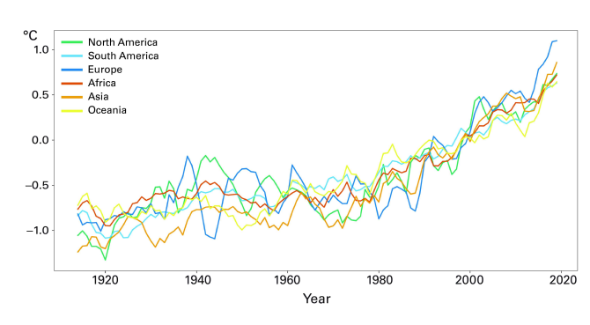

Problem Definition
Continental Temperature Variation Between 1910 and 2019
[Data source: NOAA]
Concerns about climate change keep growing every year
One priority of our generation is increase of renewable energy production and consumption.

Slide 5


Problem Definition
What kind of renewable energy?
How much?

Slide 6
02
Data Source

Slide 7
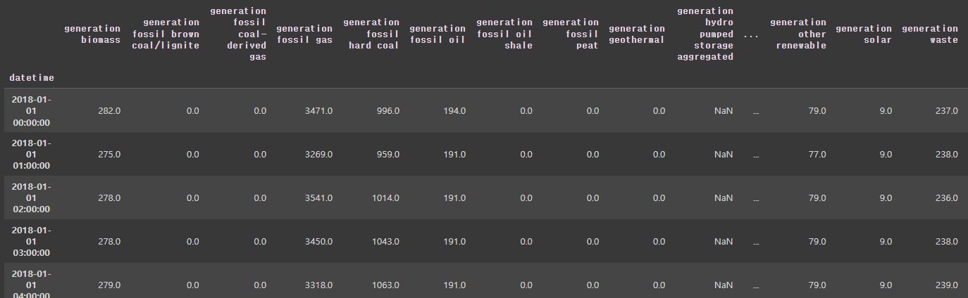
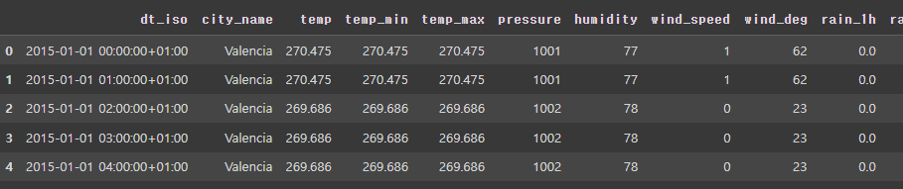
Data Set
1. Weather climate -> the amount of renewable energy production
2. Resale surplus power electricity -> electricity price
Columns: generation solar, forecast solar day, etc.

Slide 8
03
Purpose of the Analysis

Slide 9
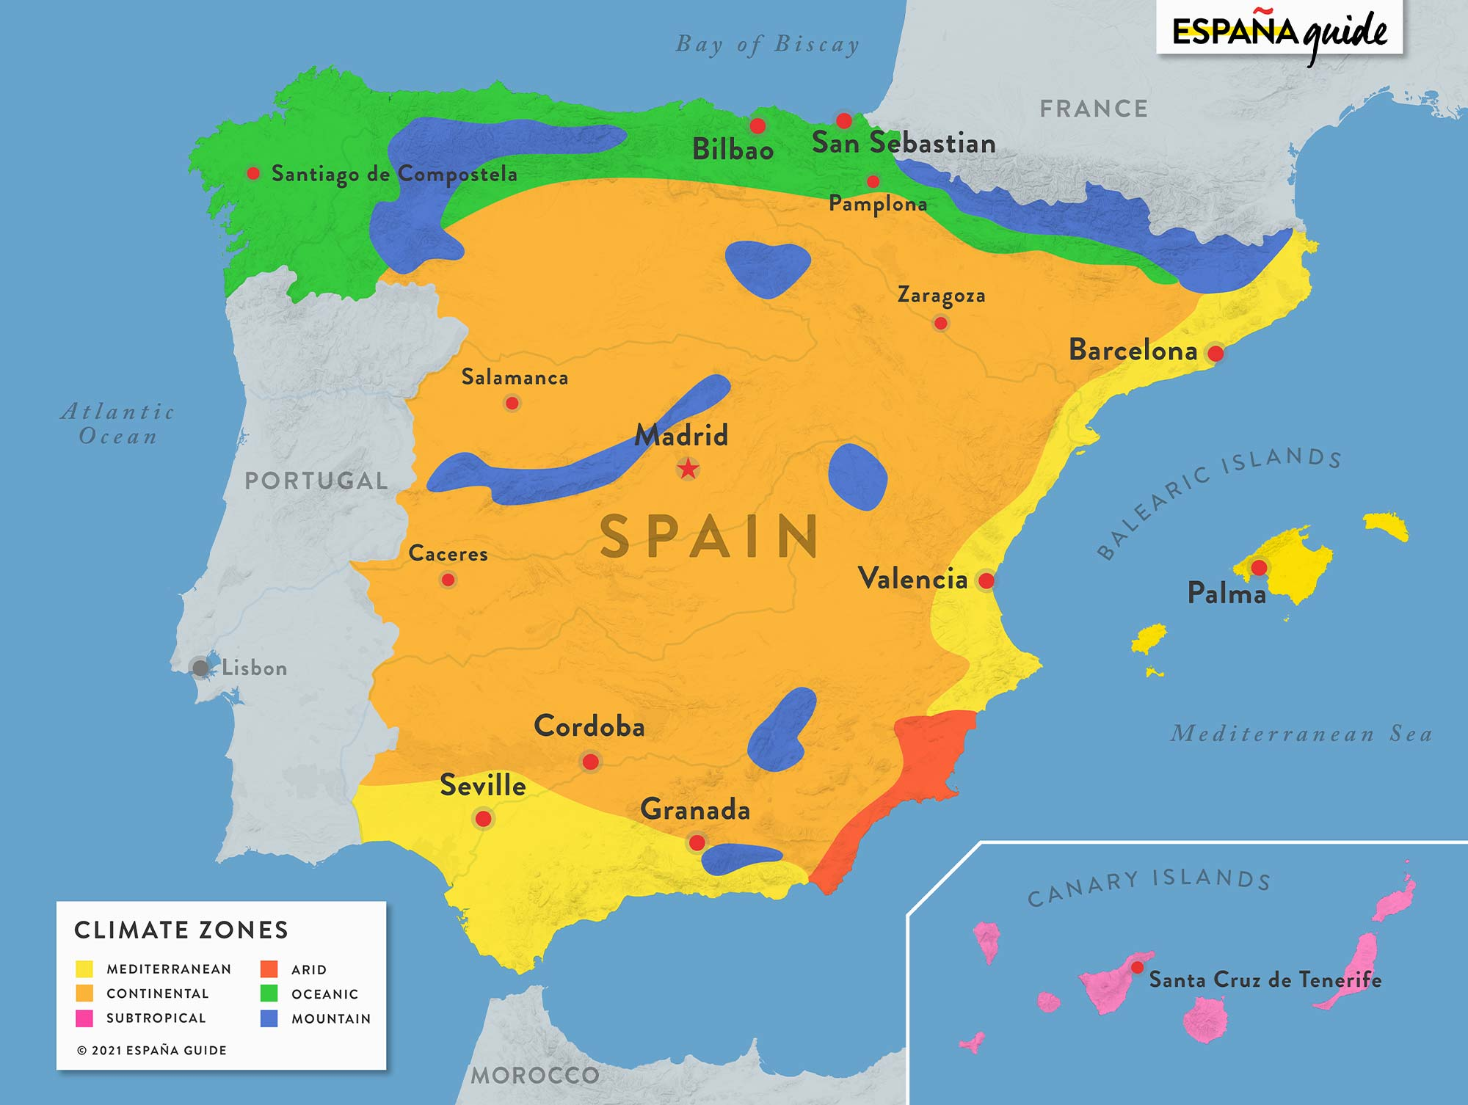
Purpose of the Analysis
Energy consumption
Renewable 40%
Non-renewable 60%
20
40
60
80
100
Weather
Spain has a lot of different climate zones that each can be prone to a certain energy production.
The weather can also influence the energy consumption.
More energy used in winter for example

Slide 10
Purpose of the Analysis
OVERALL GOAL
MAIN GOAL
Analyze the relationship between weather and renewable energy
Find an optimal policy to distribute renewable energy efficiently in each region of Spain with appropriate price based on weather-related energy generation and consumption data

Slide 11


Purpose of the Analysis
Constraint
Our energy distribution policy considers only electric power transmissions from REE national power plants to substations of each company.
Loss of power due to distance is not considered.

Slide 12
Purpose of the Analysis
Hypothesis
The price we predict could greatly enhance the profit of the entire region, rather than the price of electric energy under the TSO's current system.
Our end goal
Our end goal in this project is to promote the development of renewable energy in the local market, to increase the acceptability of local renewable energy by presenting better policies than TSOs, and to respond to power peak times.

Slide 13
04
Project Plan

Slide 14
Schedule for the term project
Work | w7 | w8 | w9 | w10 | w11 | w12 | w13 | w14
Problem Definition
Data Acquisition
Data Preprocessing
Exploratory Data Analysis
Data Mining [Modeling]
Data Post Processing [Hypothesis Test&Evaluation]
Visualization
Final Presentation

Slide 15
References
https://www.permaculturenews.org/2015/06/23/solar-energy-what-is-the-problem-and-what-is-the-solution
Analysis of Spanish Energy Policy and Cooperation with Korea
Renewable Energy Issues in the German Electricity Industry
https://www.kaggle.com/datasets/nicholasjhana/energy-consumption-generation-prices-and-weather?select=energy_dataset.csv
https://www.kaggle.com/datasets/nicholasjhana/energy-consumption-generation-prices-and-weather?select=weather_features.csv

Slide 16
Thank You!

